Slide 1
C# (Language Fundamentals)

Slide 2
A simple C# program
using System;
class HelloClass{
static void Main(){
Console.WriteLine(“Hello World!!!”);
}
}
This program prints “Hello World!” in the console window.
This code can either be written in any text editor like notepad or can be written by creating a new Project in Visual C# 2008.
Writing in notepad will requires compilation from the command prompt while in Visual C# 2008 we can use the compilation buttons in the studio.

Slide 3
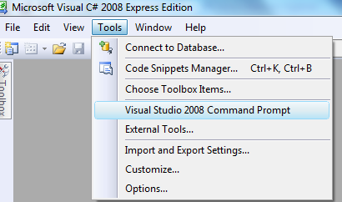
Saving and compiling from command prompt
Write the code in the notepad and save the file with extension .cs (Test.cs)
Select Start Menu→ Visual Studio Tools →Visual Studio Command Prompt or
Open the Visual C# Express edition. Select Tools→ Visula Studio 2008 Command Prompt or
Locate csc.exe , open the command prompt and Set path to the location where csc.exe is found. path=%path%;C:\Windows\Microsoft.NET\Framework\v3.5

Slide 4
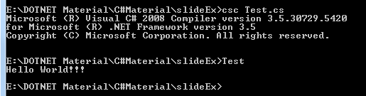
Go to the location where you saved your file from the command prompt window and compile the file: csc Test.cs
After successful compilation .EXE file is created(Test.EXE)
Execute the EXE file

Slide 5
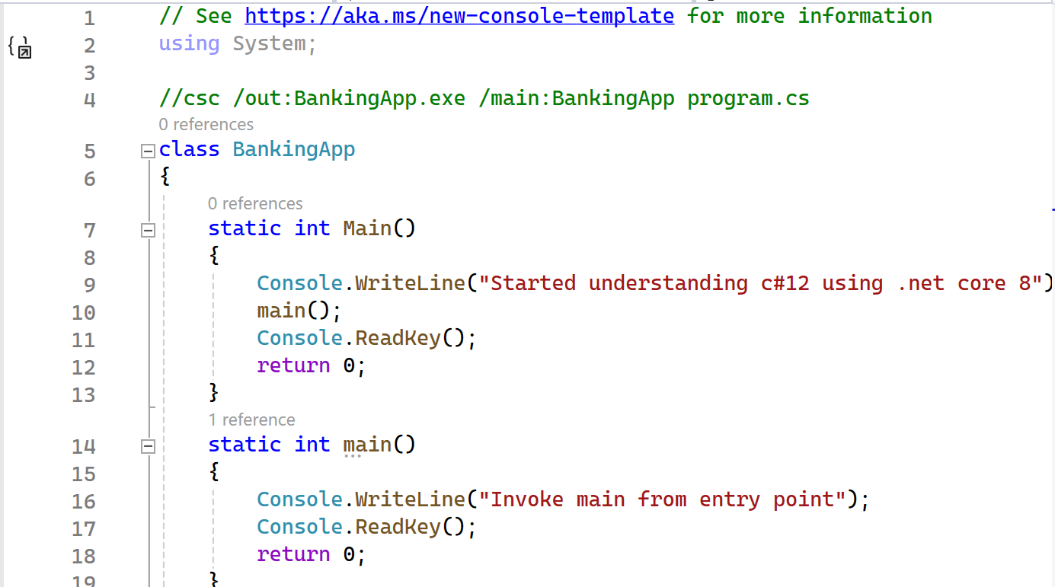
Multiple Mains in One CS File

Slide 6
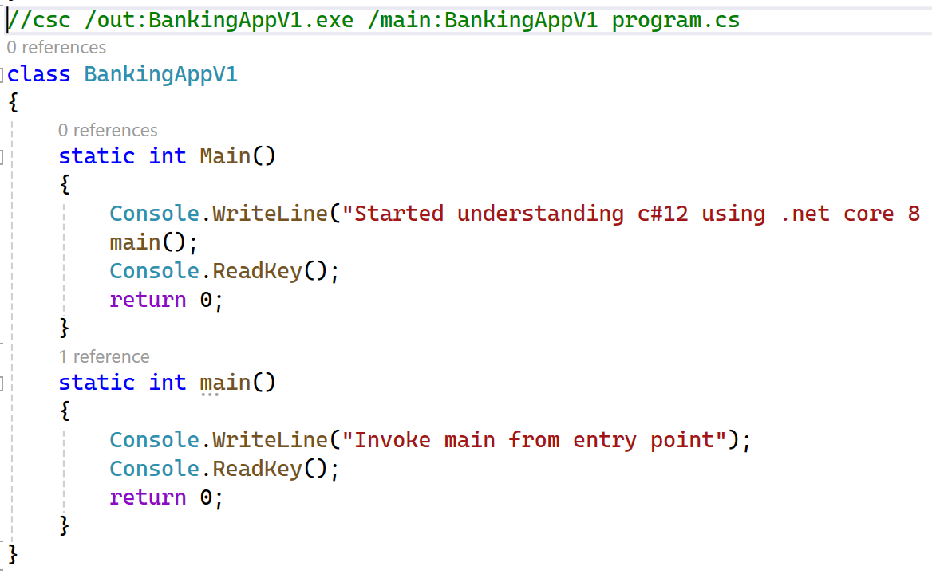
Multiple Mains in One CS File

Slide 7
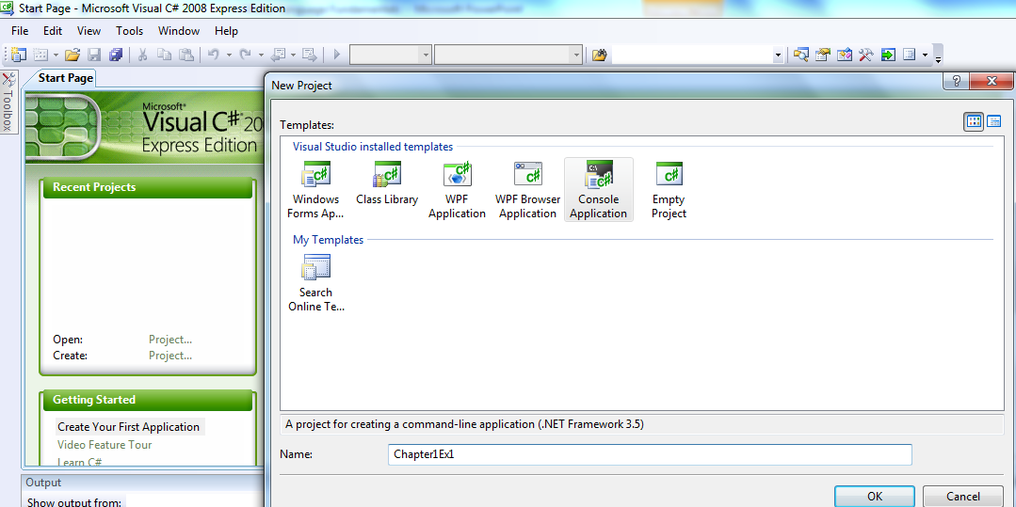
Executing C# code in Visual C# 2008
Open the Visual C# 2008 express edition.
Create new Console Based project by selecting File→New Project and select Console Application.
Provide a name say Chapter1Ex1 and click OK

Slide 8
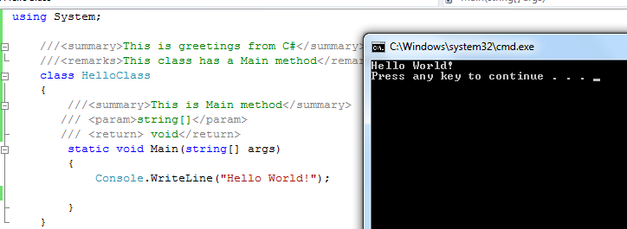
Write the code in the editor that opens up (delete the exiting code).
Ctrl + F5 to start your console app.

Slide 9
Understanding the code
using System;
class HelloClass{
static int Main(){
Console.WriteLine(“Hello World!”);
return 0;
}
}
Namespace library that has to be included for printing and reading from console
C# requires you put all the code inside a construct called class.
Execution starts from here
Writes Hello World! on the console
C# is an object-oriented language unlike C which is structured language. We will understand object-orientation in the next session.
For the sake of understanding, assume class is similar to struct in C but here you can define both variables and functions

Slide 10
Variations on Main() method
Other ways in which Main can be written are:
static void Main(string[] args)
static void Main()
static int Main()
Note that if the Main( or nay other method) has int (or anything else other than void) as return type, then all the code paths must return value of int ( or the respective type)

Slide 11
Tell me what
What is a method?
In object-oriented language a function is called method. We will look into details of In object-orientation in the next session. Now for simplicity we can continue thinking of method as function.

Slide 12
Comments
Single line comment
//
// This is a single line comment
Multiline comments
/* */
/* This is a multi
line comment */
Comments for Web reports
These comments help creating documentation in the form of XML pages
///
Example in the next slide

Slide 13
Comments in Web page
The comment code are added inside a special tags (xml tag)
<summary></summary> Describes a member for a type.
<remarks></remarks> Specifies overview information for a class or other type.
<param></param> Used in the comment for a method declaration to describe one of the parameters for the method.
<returns></returns> Used in the comment for a method declaration to describe the return value.
<newpara></newpara> Starts a new paragraph in the comments..

Slide 14
Code with ///
using System;
///<summary>This is greetings from C#</summary>
///<remarks>This class has a Main method</remarks>
class HelloClass
{
///<summary>This is Main method</summary>
/// <param>string[]</param>
/// <return> void</return>
static void Main(string[] args)
{
Console.WriteLine("Hello World!");
Console.Read();
}
}

Slide 15
Creating and Viewing the documentation
Right click on the project in the solution explorer and open Properties
In the Build tab, tick on the XML documentation file and provide a name say doc.xml.
Note that location of the file is in the bin\Release\ (this also can be changed, but for now we leave this as it is)
Save and close the property file.
Right click on the project and click on Build.
Open the bin\Release\ of you project and you will find doc.xml file.
The file generated will have content similar to the next slide.

Slide 16
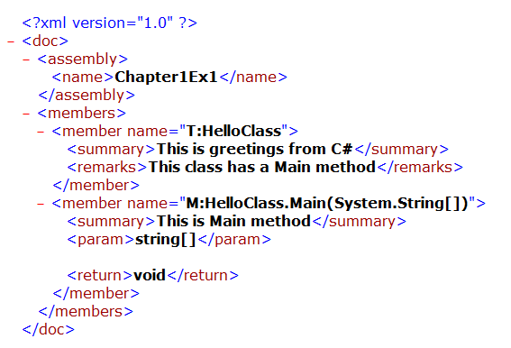

Slide 17
Identifiers Naming Rules
Identifiers are variables, methods , class or nay other named constructs in C#
Rules
Should not be a keyword
Must start with a letter or underscore or @
Subsequent characters can be a letter, number or underscore
Two identifiers are identical if
after the prefix "@", if used, is removed they are same
Each unicode-escape-sequence is transformed into its corresponding Unicode character.
Any formatting-characters are removed.

Slide 18
Verbatim identifier
An identifier with an @ prefix is called a verbatim identifier.
The prefix "@" enables the use of keywords as identifiers that may be useful when interfacing with other programming languages.
The character @ is not actually part of the identifier, so the identifier might be seen in other languages as a normal identifier, without the prefix.
@ prefix can be used with identifiers that are not keywords also but this is strongly discouraged.

Slide 19
Variables
Variables are storage locations which are associated with a value.
The value that a variable stores are of certain data type.
There are different types of variables that can be defined in C# depending on the scope : static variables, instance variables, array elements, value parameters, reference parameters, output parameters, and local variables.
There are strictly no global variable in C#.
At this point we shall look at local variables only.
The variables created inside Main() are local. They are available only inside the method where they are declared.
The local variable must always be initialized before using.

Slide 20
Keywords
abstract | event | new | struct | decimal
as | explicit | null | switch | default
base | extern | object | this | int
bool | false | operator | throw | double
break | finally | out | true | else
byte | fixed | override | try | enum
case | float | params | typeof | lock
catch | for | private | uint | long
char | foreach | protected | ulong | namespace
checked | goto | public | unchecked | stackalloc
class | if | readonly | unsafe | static
const | implicit | ref | ushort | string
continue | in | return | using | internal
delegate | interface | sbyte | virtual | is
do | short | sealed | volatile | void
sizeof | while

Slide 21
C# Data types
C# like C and C++ is a strongly typed language and so every variable must have a data type.
Data types in C# are of 2 types
Value
Built in types like int, char or user defined types created using struct or enum
For every value type there is a type in BCL
They are allocated in stack
Reference
User defined type created using class or interfaces
Reference types are allocated in heap at runtime like pointers.
We will look into this later

Slide 22
C# Value Types
Boolean type
bool
Integer types
byte int long sbyte short uint ulong ushort
Character type
char
Floating point types
decimal double float
enum
struct
We will do this later

Slide 23
Boolean Type and Boolean Literal
bool keyword is alias for System.Boolean.
This datatype is CLS compliant (it can be used by any other .NET language)
bool literal values are
true
false
Example:
bool b = true;
Console.WriteLine(b); // prints True
b=false;
Console.WriteLine(b); // prints False

Slide 24
Integer types
C# type | CLS compliant | System Type | Range
sbyte | No | System.Sbyte | -128 to 127 (signed 8-bit)
byte | Yes | System.Byte | 0 to 255 ( unsigned 8 bit)
short | Yes | System.Int16 | -32768 to 32767 (signed 16 bit )
ushort | No | System.UInt16 | 0 to 65535 (unsigned 16 bit)
int | Yes | System.Int32 | -2147783648(-2³¹) to 2147483647(2³¹-1) (signed 32 bit)
uint | No | System.UInt32 | 0 to 2³²-1(unsigned 32 bits)
long | Yes | System.Int64 | -2⁶³ to 2⁶³-1(signed 64 bit number)
ulong | No | System.UInt64 | 0 to 2⁶⁴-1(unsigned 64 bit number)

Slide 25
Integer literal
Integer literals can be written in two ways
Decimal: Example: 345, 2345678901
Hexadecimal where decimal numbers from 0 to 15 is represented as 0-9A-F: Example 0x11, 0XFF
Integer literals types
Literal with no suffix (example 25) → could be int, uint, long, ulong
Literal with u or U as suffix (25u, 35U) → could be uint or ulong
Literal with l or L as suffix (6544425L, 76l) → could be long or ulong
Literal with ul or or uL or Ul or UL as suffix (25ul, 35UL) → is ulong
Any value outside the range generates compilation error.
byte i = 256; // error

Slide 26
Floating point types
C# type | CLS compliant | System Type | Range
float | Yes | System.Single | 1.5*10⁻⁴⁵ to 3.4*10³⁸ (32 bit floating point number)
double | Yes | System.Double | 5.0*10⁻³²⁴ to 1.7*10³⁰⁸ (64 bit floating point number)
decimal | Yes | System.Decimal | ±1.0 × 10−28 to ±7.9 × 1028 (28-29 significant digits)

Slide 27
Floating-point literals
Floating-point literals can be written in two ways
Fixed notation: 3.14
Scientific notation: 0.314E1, 314e-2
Floating-point literal types
Literal with no suffix→ is double
Literal with F or f as suffix (Example 3.14f, 3.14F)→ is float
Literal with D or d as suffix (Example 3.14D, 3.14D) → is double
Literal with M or m as suffix (Example 3.14m, 3.14M) → is decimal
decimal d = 3.45; //error
decimal d = 3.45m; //ok
float f = 3.4;// error
float f = 3.4f;// ok

Slide 28
Unicode Character
UNICODE is a 16 bit character.
They are generally represented in hexadecimal format
“\u” in beginning of the character is used to represent hexadecimal character.
The characters represented include all basic English letters, numbers, special characters and characters from other languages also !
For example, Character ‘A’ represented in unicode as ‘\u0041’ – which is the number 65 in base 10.
The Unicode Standard encodes characters in the range U+0000..U+10FFFF
C# identifiers can be written in the form of unicode as well,
int \u0061; is same as int a;

Slide 29
Character type and Character Literal
char keyword is alias for System.Char
It is CLS compliant.
The char keyword is used to declare a Unicode character. Range is u0000 to uffff (16 bit unicode character)
Character literals can be written in the following forms
Any character within single quotes : Example ‘1’,’a’
Unicode escape sequence: Example '\u0041‘ represents the character ‘A’ in unicode
Hexadecimal escape sequence: Example '\x41‘ represents the character ‘A’ in unicode
Any escape sequence: Example \n for new-line character
char c=‘a’; //ok
char c=1; //error
char c='\u0001'; //ok

Slide 30
Escape Characters
\’ -inserts a single quote into string literal
\” -inserts a double quote
\\ -inserts a backslash into string literal
\a -triggers system alert(beep)
\n -inserts a new line
\r -inserts a carriage return
\t -inserts a horizontal tab into the string literal

Slide 31
enum
enum keyword is used for enumeration.
The default underlying type of the enumeration elements is int.
enum Month {Jan, Feb, Mar, Apr, May, Jun, Jly, Aug, Sep, Oct, Nov, Dec};
Jan is 0, Feb is 1 etc
enum Month {Jan=1, Feb, Mar, Apr, May, Jun, Jly, Aug, Sep, Oct, Nov, Dec};
Jan is 1, Feb is 2
Note that
int m=Month.Jan; //error
Explicit cast is required : int m=(int) Month.Jan;//ok

Slide 32
String and string literals
string is alias for System.String.
It is not a value type. It is a reference ( a constant pointer to an object) type.
Note that the equality operators (== and !=) are defined to compare the values of string objects, not references.
String literals can be written in two ways
Regular string literal (enclosed within double quotes): Example: “C#”, “C:\\My\\test” (uses escape char to escape the meaning of \)
Verbatim string literals (@ preceding regular string literal). @ tells the compiler to interpret the character that appears between the double quote in the exactly the same way as they are written. So instead of using escape char, a string can also be preceded by @.
Example: @“C:\My\test”, @“ This is Madam’s Pen”

Slide 33
Tell me what
C# has reference type. Does this mean that pointer can be created C# ?
C# supports pointers.
int* p1, p2; // Ok
It can be used in the same way as done in C
But it is considered unsafe. Also it is not CLS compliant.
Therefore will not be dealing with pointers.

Slide 34
Test your understanding
How can you correct the program given below?
using System;
class Str{
public static void Main(){
string s="Mile to go
before i sleep";
Console.WriteLine(s);
}}
New-line character inserted intentionally in the code
Notes:
string s=@"Mile to go
before i sleep";

Slide 35
Introducing Array Types
Array types are reference type in C#.
Array declaration and initialization
int[] n1={20,10,5,13};
Accessing array elements
n1[0]
Length of an array
n1.Length
NOTE:
int n1[]={20,10,5,13}; →error
int[5] n1;→error
int[] n1 ; n1[0]=4;→ error
More on arrays in the next topic

Slide 36
Constants
Constants are the variables whose values cannot change
Keyword const is used.
const int i=10, j=20;
const string j = "hello";
const float j = 1 / 2;
int i = 1, j=2;
const float k = i / j; //error
const int i = 1, j=2;
const float k = i / j;

Slide 37
Operators - Arithmetic
+ | - | / | * | ++ | -- | %
Most of the operators work the same way as it did in C.
+ , - are both unary and binary operators.
++ and -- are unary pre and post increments.
/ * and % are binary operators.
Applicable to integer and floating point types
int i = 10;
int j = i+ 255;
byte k = i + 255; //error
const double PI = 3.14;
double f = PI + 12;

Slide 38
Operators -Relational
== | != | < | > | >= | <=
Relational operator return bool value – true or false.
int i=10;
int j=20;
Console.WriteLine( i>j ); // output is False
Console.WriteLine(i == 10); // output is True

Slide 39
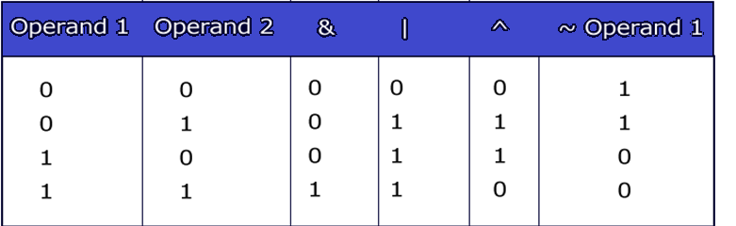
Operators - Bitwise
& | | | ^ | ~
byte x=1; // 0000 0001
byte y=3; // 0000 0011
Console.WriteLine(x&y); // prints 1
Console.WriteLine(x|y); // prints 3
Console.WriteLine(x^y); // prints 2
Console.WriteLine(~x); // prints -2
Can you compute ~x manually?

Slide 40
Operators – Logical Short Circuit
&& | || | !
These are both boolean operators. These work only on bool values.
&& and || are also called short circuit operators because they are optimized.
&& checks if the first condition is false. If it is so then it doesn't evaluate the second condition.
|| checks if the first condition is true. If it is so then it doesn't evaluate the second condition.
int i=0;
int j=2;
bool b= (i>j) && (j++>i);
Console.WriteLine(j); // prints 2
Console.WriteLine(!(i > j)); // prints True

Slide 41
Shift Operators
>> | <<
If first operand is an int or uint (32-bit quantity), the shift count is given by the low-order five bits of second operand.
If first operand is a long or ulong (64-bit quantity), the shift count is given by the low-order six bits of second operand.
The high-order bits of first operand are discarded and the low-order empty bits are zero-filled. Shift operations never cause overflows.
Console.WriteLine(2<<1); // prints 4
Console.WriteLine(-1>>2); // prints -1
Console.WriteLine(2 >>32); // prints 2
Console.WriteLine(2 >> 33); // prints 1

Slide 42
Assignment Operators
= | >= | <= | *= | /= | &= | |= | ^= | <<= | >>= | %=
int a = 10;
int b=2;
a+=b; // 12 same as a=a+b;
Console.WriteLine(a);
double d=45.3;
d/=1.2;
Console.WriteLine(d); // 37.75 same as d=d/1.2
float d1=2.4f;
d1 %= 1.2f;
Console.WriteLine(d1); // 0

Slide 43
Other operators
Operator | Name | Example
?: | Ternary operator | 10 % 2 > 0 ? 1 : 10
[] | Array subscript | a[1]
() | Cast
?? | Next Session
:: | namespace alias qualifier | Coming Up
. | dot operator | n.length
is | Next Session
as
typeof | In refection
new | Next Session
checked | Next Slide
unchecked

Slide 44
Checked and unchecked operator
byte b =255;
b++;
Incrementing the value of b causes overflow since byte can hold values in the range 0 to 255 only.
The value of b is 0 finally.
To make the CLR throw an error at runtime when overflow occurs, the above code can be written inside the checked block.
byte b =255;
checked{ b++;}
Right opposite to checked operator is unchecked operator.
Unchecked is the default behaviour.

Slide 45
Console IO
Console IO is made available by including System class library in the code through using System statement.
We have looked at Console.WriteLine and Console.Write statements.
If using statement is not included in the code then the Console must be fully qualified like the statement below
System.Console.WriteLine("hello");

Slide 46

Console output Formatting
Writing output on the console (standard output)
Console.Write(“some text”);
Console.Writeln(“some text”);
Inserts a new line at the end
Write statement can be sued to print any type of variable.
Console output can be formatted using Write statement.
Example:
int intval=90;
double doubleval=9.99;
bool boolval=true;
Console.WriteLine("Double value= {1} \n
Int value= {0} \n Boolean value= {2} ",
intval, doubleval, boolval);
Specifies the argument number

Slide 47
string formatting flags
String format character | Description
C or c | Format currency
D or d | Format decimal numbers
E or e | Exponential notation
F or f | Fixed-point formatting
G or g | Formats a number to fixed or exponential format
N or n | Used for basic numerical formatting (with commas)
X or x | Used for hexadecimal formatting

Slide 48
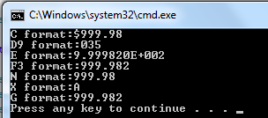
Example
Console.WriteLine("C format:{0:C} ", 999.982);
Console.WriteLine("D9 format:{0:D3} ", 35);
Console.WriteLine("E format:{0:E}", 999.982);
Console.WriteLine("F3 format:{0:F3}", 999.982);
Console.WriteLine("N format:{0:N} ", 999.982);
Console.WriteLine("X format:{0:X} ", 10);
Console.WriteLine("G format:{0:G} ", 999.982);

Slide 49
Reading inputs from the console
Console.ReadLine() Reads the next line of characters from the standard input stream.
Console.Read() reads a character and returns in the form of int.
using System;
class SayHello{
public static void Main(){
string s;
Console.Write("Please your name”);
s = Console.ReadLine();
Console.WriteLine(“Hello “+s);
}}

Slide 50
Looping Statements- for statement
There are two form of for statement
for loop
for(intialization; condition;increment/decrement){
//statements
}
Ex: for(int i=0;i<10;i++)
foreach loop:
foreach(object var in itemlist){
//statements
}
Ex: int[] arr={1,2,3,4,5};
foreach(int s in arr)
Console.WriteLine(s);
Array or Collection

Slide 51

Using WriteLine with arrays
The WriteLine method write the content of the char arrays.
public static void Main(string[] a)
{
int[] arr = { 1, 2, 3, 4, 5 };
char[] array = { 'a', 'b', 'c', 'd' };
Console.WriteLine(array);
Console.WriteLine(arr);
}

Slide 52
while and do while
while loop
while(Condition) {
statements
}
Ex: int i=0;
while(i<10) {
Console.WriteLine(i);
i++; }
do-while loop
do{
statements
}while(Condition);
Ex: int i=0;
do {
Console.WriteLine(i);
i++;
} while(i<10);
Condition must evaluate to bool value

Slide 53
Test your understanding?
while (1)
{
Console.WriteLine("hello");
}
What will happen on executing the above statement?

Slide 54
break and continue
Used with loop statements
break is used to break out of the loop. Is used with switch statement also.
continue is used to exit out of current iteration and continue with the next iteration.
int j = 100;
while (true)
{
if (j % 13 == 0) break;
else
j++;
}
Console.WriteLine(j); //104

Slide 55
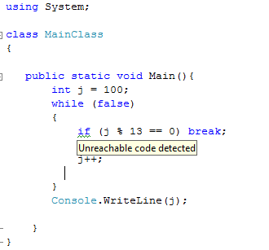
Unreachable code warning
Note how the C# compiler warns of unreachable code

Slide 56
Decision constructs
if/else statement
if(Condition)
{ statements; }
else{statements; }
Example: if (c > 0) c++; else c--;
switch statement
switch(var)
{
case val1:
statements;
break;
case val2:
statements;
break;
……
default: statements;
break; }
Condition must evaluate to bool value
Any numeric value or string
constants

Slide 57
break the switch-case
int c;
c = Console.Read();
switch(c){
case 'r': Console.WriteLine("RED");
break;
case 'g': Console.WriteLine("GREEN");
break;
case 'b': Console.WriteLine("BLUE");
break;}
}
C# compiler enforces that every case statement must have a break statement. In other words control cannot fall through from one case label to another.

Slide 58
Multiple case
int c;
c = Console.Read();
switch(c){
case 'r':
case 'R':Console.WriteLine("RED");
break;
case 'g':
case 'G': Console.WriteLine("GREEN");
break;
case 'b':
case 'B': Console.WriteLine("BLUE");
break;}
}

Slide 59
Fall through
In cases where fall-through is desired a goto statement is used
goto case caselabel
Example
int c;
c = Console.Read();
switch(c){
case 'r': Console.WriteLine("red"); goto case 'R';
case 'R': Console.WriteLine("RED");
break;
case 'g':
case 'G': Console.WriteLine("GREEN");
break;
case 'b':
case 'B': Console.WriteLine("BLUE"); break;
}

Slide 60
Conversions
Implicit conversion
Happen automatically
Explicit conversion
Cast need to be called
All the cast must be static (known at compile-time)

Slide 61
Implicit Conversions
Identity conversions
Implicit numerical conversions
Implicit constant expression conversions
Implicit enumeration conversions
Implicit reference conversions
Boxing conversions
Implicit type parameter conversions
User-defined conversions
We will look at these now

Slide 62
Identity conversions
Involves conversion from one type into the same type.
Example:
int k;
int j=k;→ identity conversion happen automatically

Slide 63
Implicit numerical conversions
sbyte → short, int, long, float, double, decimal
char →int, long, float, double, decimal, ushort, uint, ulong
byte →short, ushort, int, uint, long, ulong, float, double, decimal
short →int, long, float, double, decimal
ushort →int, uint, long, ulong, float, double, decimal
int →long, float, double, decimal
uint →long, ulong, float, double, decimal
ulong, long →float, double, decimal
float → double
Note that some of the above conversion will cause loss of precision but not loss of magnitude.

Slide 64

Example
using System;
class Convert{
public static void Main(){
char c='A';
int i=c;
Console.WriteLine(i);
long l=23456789100;
float f=l;
Console.WriteLine(f);
}}
vice versa is not allowed implicitly
Loss of precision !

Slide 65
Implicit constant expression conversions
A constant-expression of type int can be converted to type sbyte, byte, short, ushort, uint, or ulong, provided the value of the constant-expression is within the range of the destination type.
A constant-expression of type long can be converted to type ulong, provided the value of the constant-expression is not negative
byte b=255;//ok
byte b=256;//error

Slide 66
Implicit numeric conversions
An implicit enumeration conversion permits the decimal-integer-literal 0 to be converted to any enum-type.
using System;
class MainClass
{
enum Month { Jan, Feb, Mar, Apr, May, Jun, Jly, Aug, Sep, Oct, Nov, Dec };
public static void Main(){
Month m1;
m1 = Month.Apr;
const int i = 0;
const int i1 = 1;
m1 = i; //OK →Implicit enumeration conversions
m1 = i1; //error
m1 = 1; //error
int i2 = Month.Apr; //error
}
}

Slide 67
Casting
Any conversion that happens in the opposite direction of implicit numerical conversions requires explicit request from the compiler through casting.
Casting
Number casting example
long l2 = 12500;
int i2 = (int)l2;
Enum casting example
enum Month { Jan, Feb, Mar, Apr, May, Jun, Jly, Aug, Sep, Oct, Nov, Dec };
public static void Main(){
Month m1;
m1 = Month.Apr;
m1 =(Month) 1;
int i2 =(int) Month.Apr; }

Slide 68
Arithmetic operation
Any arithmetic operation on 2 integer types (other that long) results in int.
byte b1 = 1;
byte b2 = 2;
byte b3 = b1 + b2; // error
byte b3 =(byte)( b1 + b2) ; // ok
Same is the case with short.
The type result arithmetic operation is same as that of the largest type of the operands.
Example 1:
float b1 = 1f; int b2 = 2;
float b3 = b1 + b2;
Example 2:
long b1 = 1; double b2 = 2;
double b3 = b1 + b2;

Slide 69
Convert
Note conversions of numeric value to string and vice versa, bool to string and vice versa etc. is not possible either implicitly or explicitly.
This can be done through the methods below:
Example:
/* Boolean values */
bool ii = Convert.ToBoolean(10);
Console.WriteLine(ii); //True
ii=Convert.ToBoolean(0.0);
Console.WriteLine(ii); //False
ii= Convert.ToBoolean("true");
Console.WriteLine(ii); //True
ii = Convert.ToBoolean("gg");
Console.WriteLine(ii); // Runtime error

Slide 70
/* String values */
string s= Convert.ToString(true);
Console.WriteLine(s); //True
s = Convert.ToString(1.23);
Console.WriteLine(s); //1.23
s = Convert.ToString('A');
Console.WriteLine(s); //A
/* Numeric Values */
int i = Convert.ToInt32("1009");
short j = Convert.ToInt16("100");
long k = Convert.ToInt64("9292929");
byte b=Convert.ToByte("20");
double d=Convert.ToDouble("sss"); // runtime error
Similarly there are methods for all the int numeric types
No ToFloat method!
Take a peek at all the other methods using IntelliSense of VS2008

Slide 71
Processing Command Line Arguments
There are 2 ways to get command line arguments:
Main() method with string array argument is to be used if we desire to get the command line arguments
public static int Main(string[] args){}
The command line argument counting begins excluding the first string which is the executable file name with its path.
Using Environment.GetCommandLineArgs() method which returns an array of strings.
public static void Main(){
string [] args=Environment.GetCommandLineArgs(); }
The command line argument counting begins including the first string which is the executable file name with its path.

Slide 72

Example-Command Line Arguments
C:\Test.cs
using System;
class HelloClass{
public static int Main(string[] args){
Console.WriteLine(args.Length);
for(int i=0;i<args.Length;i++)
Console.WriteLine(“Arg {0}”,args[i]);
return 0; }}
If no arguments is provided the code displays 0.
Find out what will happen if args[0] is accessed without command line arguments?

Slide 73
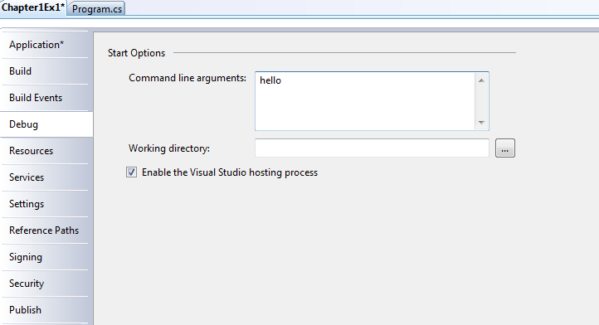
Command line in VS 2008
Right click on the project and click on properties.
Select Debug tab and enter command line arguments in the space provided. Save and close

